Slide 1

Video call system
By Tony Jiang

Slide 2
Contents
Initial situation
Approach/research document
Demo solution 1
Problem
Challenges faced
App overview
Concepts
Added feature solution 1
Demo solution 2

Slide 3
Initial situation
SVb (Sociale Verzekeringsbank)(Social Insurance bank) in Aruba.
PRAS (Pensioen Registatie en Administratie Systeem)(Pension Registration and Administration System) desktop application.
ITP Caribbean.
Purpose of the video call.
The current situation.
Notes:
SVb ensure the community of Aruba receives an income through AO/ unfit for workday, old age pension, widow’s pension, and orphan pension.
Purpose of the video call is to determine if the retiree, that is living abroad is still alive. So that SVb can create a report of the interview and gives approval for the continuation of the pension payments for the next period. This process isthan repeated.
Current situation facilitate video call on tablet.
Few problems: human error and take time to search.

Slide 4
Problem
ITP Caribbean needs to come 2 or 3 prototype solutions and present it to the client.
Notes:
Present the features of each product and show how it will benefit SVb.

Slide 5
Approach
Agile scrum
Notes:
allows for flexibility, constant feedback, and collaboration, ultimately leading to a higher quality end product that meets the needs of all stakeholders.

Slide 6
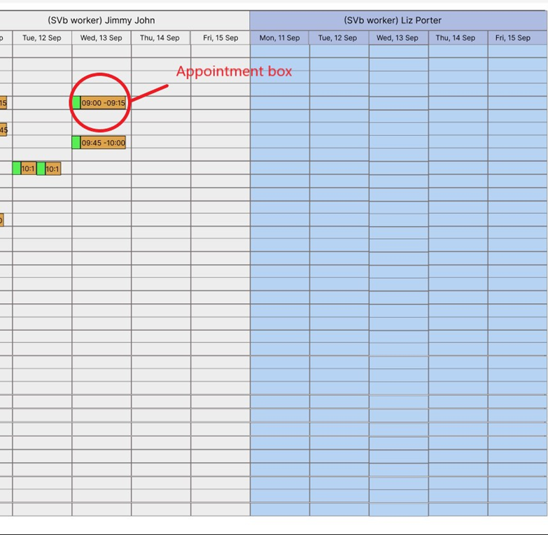
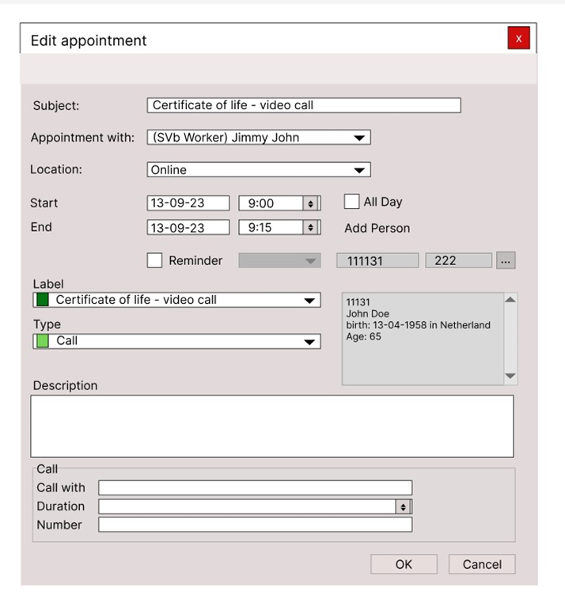
App overview

Slide 7
Demo solution 1

Slide 8
Added feature solution 1

Slide 9
Demo solution 2

Slide 10
Challenges faced
Generals
Learning how VB.NET work.
Understand and learning which class/ object to properly use/ call.
Research on video call systems.
Prototype 1
Retrieve the numbers.
Validate number on the number field.
Prototype 2
Learn the functionalities of the API.
Structure the classes.
Learn browser packages.

Slide 11

Thank you

Slide 12

Questions?

